Slide 1
Cloud Migration & Implementation Delivery at Accenture
Tabitha Chew
February 15, 2018

Slide 2
TABITHA CHEW
EXPERIENCE
> Accenture > Cloud Sherpas > Plantronics > UC Santa Cruz ITS
EDUCATION
UC Santa Cruz, B.S. Technology & Information Management (2011-2014)
HOBBIES & INTERESTS
> teaching swimming > traveling

Slide 3
What is Accenture?

Slide 4
ABOUT Accenture company Overview
global management consulting and professional services firm
provide strategy, consulting, digital, technology, and operations services
help organizations maximize their performance and achieve their vision
develop and implement technology solutions to improve our clients’ productivity and efficiency – and may run parts of their business
enable our clients to become high-performance businesses and governments
2017 Net Revenue of $34.9B with more than 435,000 employees

Slide 5
About Accenture What we do
Shapes the future at the intersection of business & technology Transforms businesses through industry expertise & insights Creates value through new experiences, new intelligence & new connections Powers businesses with cutting-edge solutions using established & emerging technologies Delivers outcomes through infrastructure, security, cloud & business process services
Notes:
Our 5 businesses – strategy, consulting, digital, technology, and operations – develop and deliver integrated services and solutions for our clients.
STRATEGY – The people who come in, do a health check, recommend a future state, and design a plan to get there.
CONSULTING – The people who come in and help the client follow that plan through change management, training, project planning, systems integration, etc. Industry-specific business model transformation, meaning you’re aligned to delivering solutions based on a specific industry such as Financial Services or Health.
DIGITAL – combines our capabilities in digital marketing, analytics, and mobility
TECHNOLOGY – Provide insights for CIOs and tech leaders to futureproof IT by delivering solutions based on a specific technology, like Salesforce or Oracle.
OPERATIONS – Offer insights to help C-Suite executives attain high performance through BPS, AAS, infrastructure, and cloud. Provides technical solutions that can be based on the latest technical trends, like data migration between data centers or cloud-based solutions like ServiceNow.
college grads enter as analysts, move up to consultant, then managing positions

Slide 6
WHAT SETS US APART, BY THE NUMBERS
WE SERVE CLIENTS IN MORE THAN
120
countries
WE WORK ACROSS MORE THAN
40
industries
OF OUR TOP 100 CLIENTS
98
have worked with us for at least 10 years
WE HAVE MADE
16
consecutive appearances in Fortune’s “World’s Most Admired Companies” list
WE HAVE
6K
Patents and patent pending applications in 44 countries
Notes:
We partner with 95 of the Fortune Global 100 and more than three-quarters of the Fortune Global 500.
#40 – 2018 Fortune’s World’s Most Admired Companies [#41, 2017]
#1 – Industry Ranking: Information Technology Services [#1, 2017]

Slide 7
offer insights to help C-Suite executives attain high performance through business processing services, infrastructure services, security services, and cloud services
operate IT infrastructure and business processes on behalf of clients, increasingly powered by data, artificial intelligence, analytics & digital technologies, on an as-a-service basis, to help improve their productivity, experience, and performance
Notes:
Provides technical solutions that can be based on the latest technical trends, like data migration between data centers or cloud-based solutions like ServiceNow.

Slide 8
BUSINESS PROCESSING SERVICES
Powered by data, artificial intelligence, analytics, and digital technologies to help improve productivity, experience, and performance.
INFRASTRUCTURE & CLOUD SERVICES
Design, implementation, migration, and managed services to help transform and optimize IT infrastructures—on-premise, in the cloud, or a hybrid of the two.
ServiceNow

Slide 9
What is ServiceNow?

Slide 10
FASTEST-GROWING ENTERPRISE SOFTWARE COMPANY WITH MORE THAN
$1B
IN REVENUE
SERVICENOW BECAME A PUBLICLY TRADED COMPANY IN
2012
5600
EMPLOYEES
73
WORLDWIDE LOCATIONS
OF THE FORBES GLOBAL 2000 COMPANIES
814
ARE SERVICENOW CUSTOMERS
1000+
PARTNERS
16
DATA CENTERS
97.7%
CUSTOMER RENEWAL RATE
10
Notes:
ServiceNow is a cloud computing company founded in 2004 in San Diego. Shortly after going public, ServiceNow relocated its HQ from San Diego to Santa Clara.
NYSE: NOW
ServiceNow was the first technology company taken public by Morgan Stanley since Facebook and at the time some called it the anti-Facebook or the company that revived the IPO market.

Slide 11
Nonstop Cloud Infrastructure
data encryption
global infrastructure
governance & industry compliance
real availability
advanced high availability architecture
multi-instance architecture
Notes:
Most enterprises would choose cloud solutions (such as ServiceNow) over on-prem solutions.
ServiceNow cloud infrastructure is always on. No customer instance is ever offline or taken down for any reason.

Slide 12
MULTI-INSTANCE ARCHITECTURE
deploy & upgrade on your own schedule
customize your cloud services
trust that your data is segregated from other customer instances
Notes:
ServiceNow’s cloud infrastructure uses an advanced multi-instance architecture so every customer gets its own unique application logic and database.
Ensures that your instance is logically separated from all other tenants in our cloud environment.

Slide 13
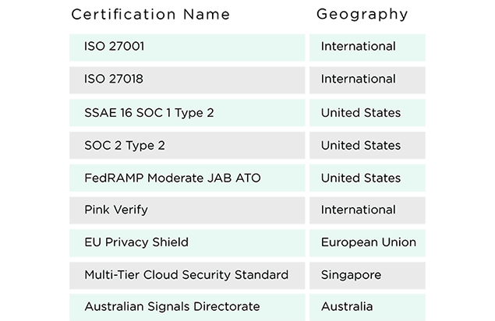
Security & Compliance
deliver comprehensive geographical and industry compliance
Notes:
ServiceNow secures their cloud and customer data using multiple technologies and levels of security that have been certified compliant by third-party organizations.

Slide 14
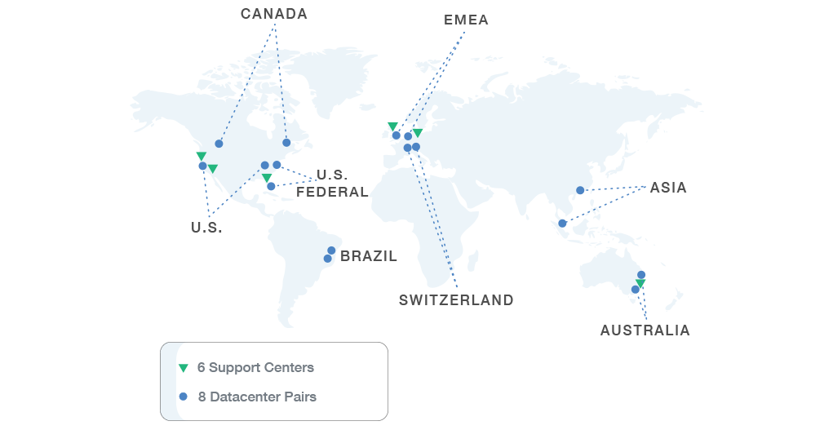
HIGH-AVAILABILITY GLOBAL INFRASTRUCTURE
designed for Global 2000 enterprises
16 data centers across 5 continents
near-perfect availability
Notes:
Our Nonstop Cloud is designed for Global 2000 enterprises in terms of availability, location, and scale.
We run 8 pairs/16 data centers across 5 continents to meet our customer’s physical location and data sovereignty needs.
We focus on near‑perfect availability, own and operate all our data center equipment and hire full‑time data center employees.

Slide 15
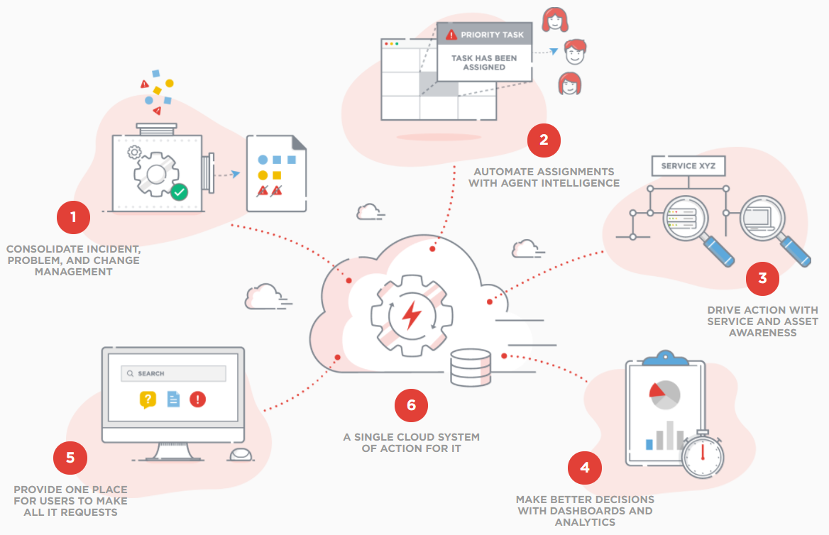
ServiceNow Solution Modernize IT Service Management
Notes:
Provide consistency across processes with shared configuration items and service level goals.
Use Agent Intelligence to automatically triage incidents, and integrated collaboration to improve teamwork.
Automate discovery of IT services and assets to gain visibility into cost of ownership and get fast resolution.
Use dashboards to get actionable insight into service demand, service level compliance, and other key performance indicators.
Request and track services through a single service portal and from any device – creating a consumer-like experience.
Drive IT efficiencies and reduce costs by consolidating on-premises tools and infrastructure on the ServiceNow platform.

Slide 16
Accenture’s ServiceNow Practice
Notes:
Accenture’s ServiceNow practice helps organizations determine how to best respond to changing business needs and coordinate services across the enterprise for greater speed, agility and efficiently, all delivered at scale.

Slide 17
Accenture’s ServiceNow Practice
Certified ServiceNow Partner
resell, build, integrate, and implement solutions that extend the capabilities of the ServiceNow platform (out-of-the-box)
1 of 5 Global Strategic Partners
Gold Sales Partner
Gold Services Partner
Authorized Training Partner
Certified Professionals
Certified System Admin: 580
Certified Implementation Specialist: 215
Certified Application Developer: 76
Notes:
Accenture has significantly more ServiceNow Trainers than ServiceNow itself.
We offer various types of mixed media training with courses for admins/end users as well as custom training packages.

Slide 18
Accenture’s ServiceNow Practice
Sales
statement of work
Delivery
health check
requirements gathering
on-site workshop
development
go-live
post go-live support
Notes:
A statement of work (SOW) defines project-specific activities, deliverables, and timelines for us to provide services to a client.

Slide 19
Accenture’s ServiceNow Practice
Applications
Asset Management
Change Management
Configuration Management Database
Facilities Management
Financial Management
Human Resources
Incident Management
Knowledge Management
Problem Management
Project Management
Service Catalog

Slide 20
My Life as a consultant

Slide 21
PROJECT EXPERIENCE
PROJECT ROLES
> Business Analyst > Development Lead > Implementation Specialist > Product Owner > Scrum Master
SERVICENOW APPS
> Asset > Change > CMDB > Facilities > Financial > Human Resources > Incident > Knowledge > Problem > Service Catalog
INDUSTRIES
> Aerospace > Commercial Banks > Educational Services > Entertainment > Food Services > Insurance: Health > Oil & Gas Equipment > Professional Services > Real Estate > Retailers: Apparel
COUNTRIES
> US > Canada > Italy
Notes:
CLIENT: largest technology merger in history, Canada’s largest independent oil & gas producer, Accenture CIO

Slide 22
PROJECT EXPERIENCE
> Largest technology merger in history (incident, problem, change, knowledge, service catalog)
> Canada’s largest independent oil & gas producer (gendev)
> Accenture (support portal, leave of absence)

Slide 23
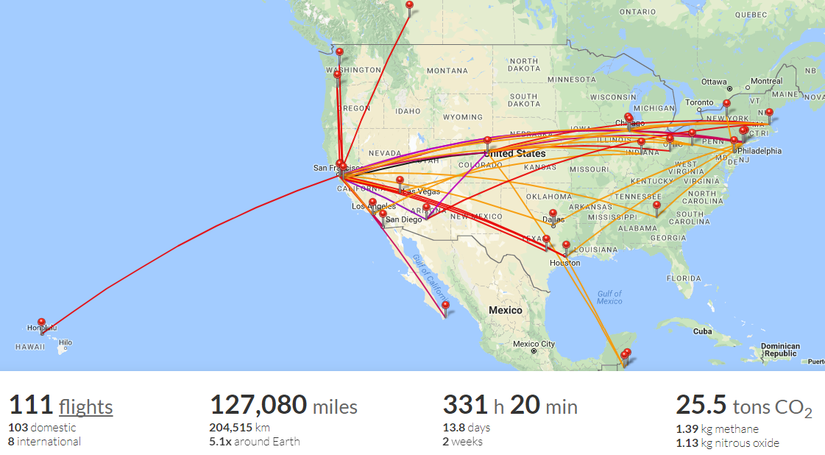
TRAVEL
Notes:
https://my.flightradar24.com/tabasaur

Slide 24
WHY CONSULTING?
> you’ll skip the C-Suite line
> you get to try a lot on
> you’ll get an almost instant network
> you’ll quickly become an expert
> you’ll have more opportunities to grow
Notes:
Many people work their whole lives to climb the corporate ladder and begin working on company-wide strategic problems. There are very few professions or opportunities where you can skip the years of executing day to day duties and jump straight to working on and solving these problems. Consulting presents a unique opportunity to get exposure to this type of thinking. Whether or not you stay in consulting, knowing what keeps senior leaders up at night—and knowing that you can help them address those issues—is a huge reason to get into the field.
New grads are often unsure which career field or industry they want to get into. Due to its nature of frequently changing projects, consulting allows you to rapidly try out industries, functional areas, and geographies to see what you like the most. Even if you are sure of a specific industry, consulting gives you the chance to see different company cultures.
Joining a consulting firm is one of the quickest and most effective ways to build a vast and valuable network. You will work with multiple clients and stakeholders through the course of your different projects. This will allow you to build relationships across multiple organizations with usually quite senior individuals…. Which can turn into job offers, other consulting engagements, or mentorships. Working in consulting will allow you to work with individuals who share many of your same characteristics—it’s like a gathering A-type personalities.
Learn on the job. Because projects are fast-paced and you are typically working with teams, you get to learn quickly from those who are more experienced and you’ll soon find yourself becoming an “expert” in all kinds of fields. Consultants are also expected to stay ahead of trends, so not only will you be reading about large macro trends in the industry or affecting your client, but you will also challenge and discuss these trends with other people you work with.
Plenty of opportunities to learn, grow, and progress as a professional. Word on the street is… 5 years of consulting = 1 year office job.

Slide 25
tabitha.chew@accenture.com linkedin.com/in/tabithachew

